Slide 1
Chapter 1. Introduction
1.1 Examples of Time Series
1.2 A Model-Building Strategy

Slide 2
1.1 Examples of Time Series
Definition
A collection of data which are obtained from the observations sequentially over time is called a time series.
  Sequentially: daily, weekly, monthly, quarterly, yearly, etc.

Slide 3
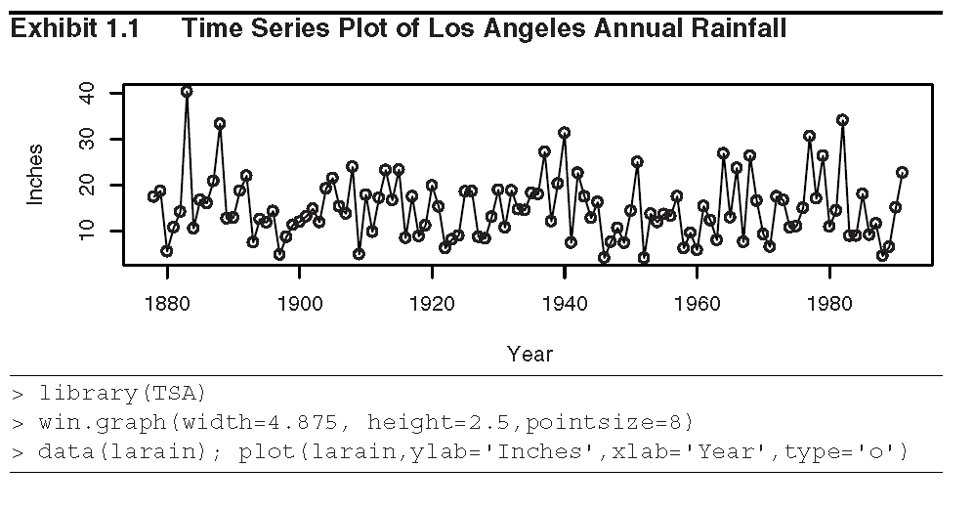
Example 1.1 (Annual Rainfall in Los Angeles)

Slide 4
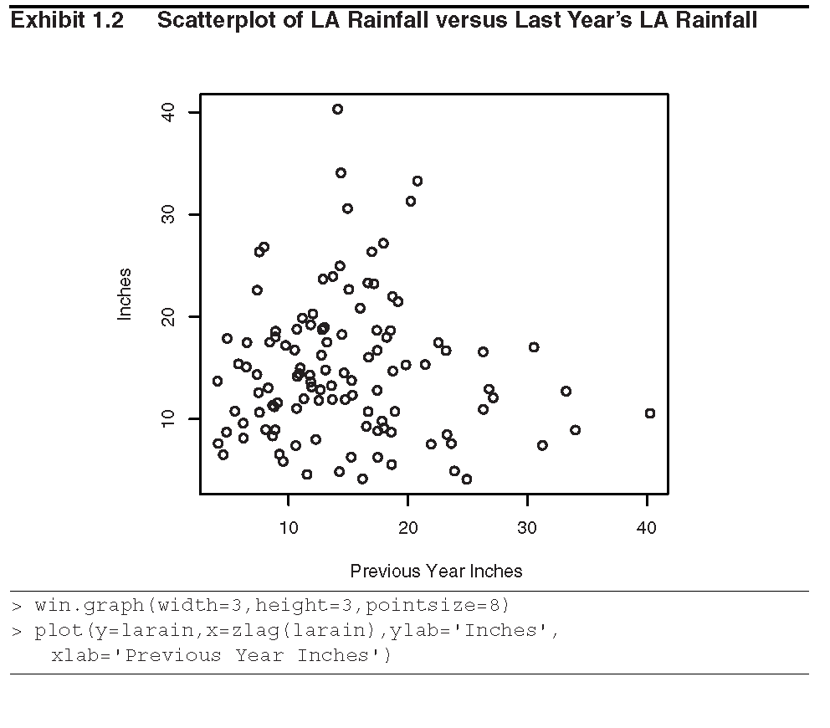

Slide 5
1.1 Examples of Time Series
Exhibit 1.1 shows considerable variation in rainfall amount over the years – some years are low, some high, and many in between the value.
Exhibit 1.2 shows that there is little correlation between last year’s rainfall amount and this year’s amount.

Slide 6
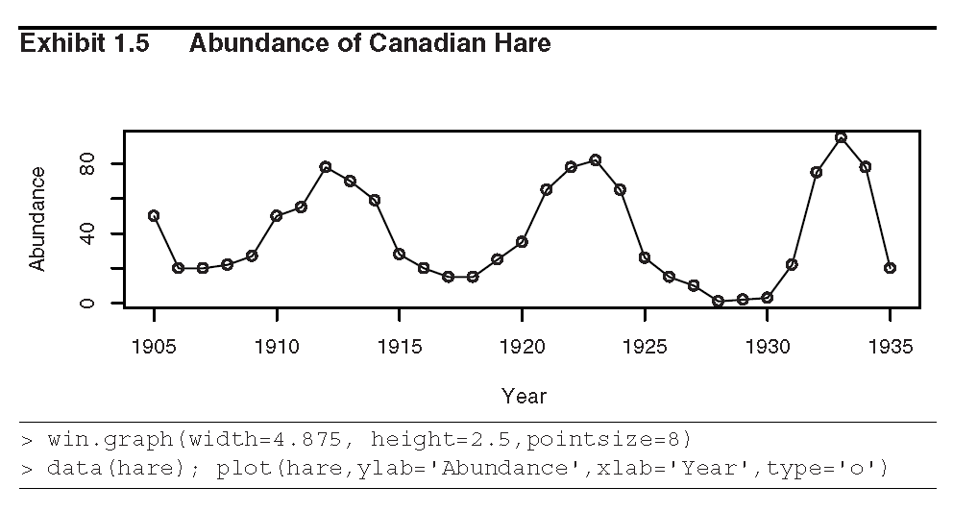
1.1 Examples of Time Series
Example 1.2 (Abundance of Canadian Hare)

Slide 7
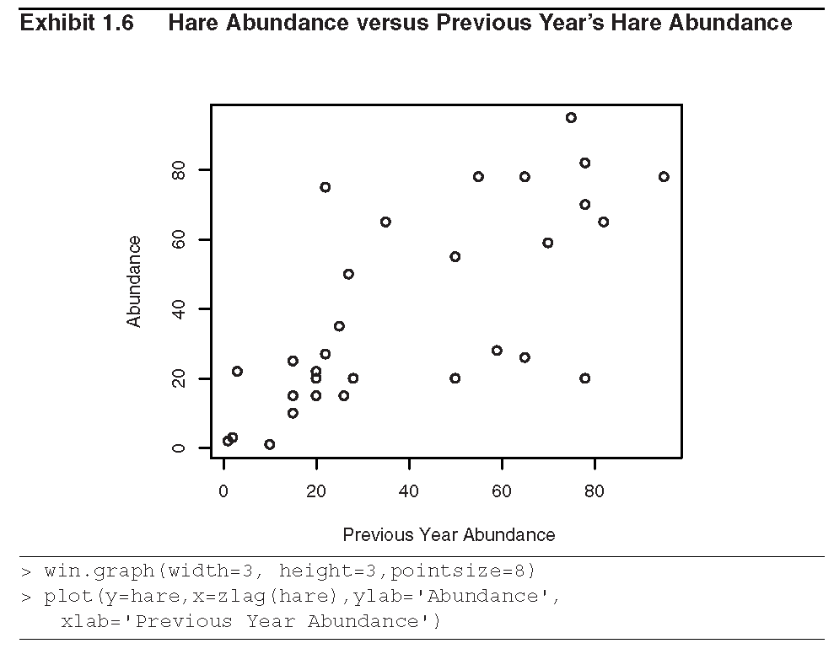

Slide 8
1.1 Examples of Time Series
Exhibit 1.5 shows neighboring values are closely related.
Exhibit 1.6 displays an upward trend which indicate that a correlation between the abundance and the previous years’ abundance.

Slide 9
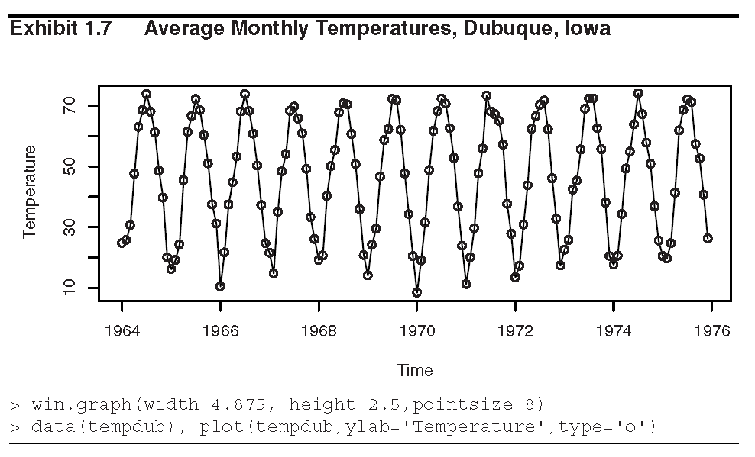
1.1 Examples of Time Series
Example 1.3 (Monthly Average Temperatures in Dubuque, Iowa)

Slide 10
1.1 Examples of Time Series
This time series displays a very regular pattern called seasonality.
  Seasonality: A more or less stable pattern of change that appears annually and repeats itself year after year.

Slide 11
1.2 A Model-Building Strategy
There are three main steps for finding appropriate models for time series:
Model Specification (or Identification)
We shall attempt to adhere to the principle of parsimony to choose a model which has the smallest number of parameters that will accurately represent the given time series data.
Model Fitting
To find the best possible estimates of the parameters for the specified model.

Slide 12
1.2 A Model-Building Strategy
Model diagnostics
To assess the quality of the model that we have specified and estimated.

